Slide 1


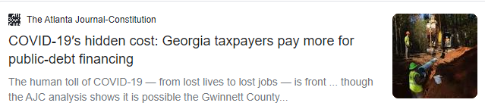

COVID and Affordable Housing In Gwinnett County

Slide 2
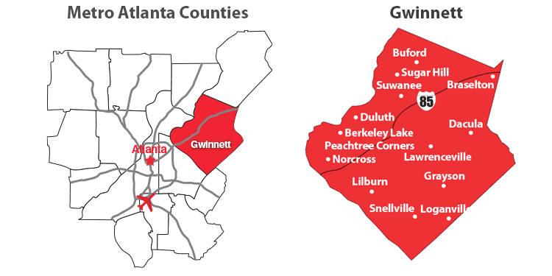
Gwinnett
Atlanta
936,000 people
301,000 households
3.1 people per household
$93,000 mean income
2,810 Low Income Units
4,396,000 people
1,792,000 households
2.7 people per household
$100,000 mean income
1,509 Low Income Units

Slide 3
Transmission Model
Transmission Chance
Chance during an exposure that a vulnerable person is infected
Exposure Rate
Number of exposures a person experiences per day
Mask Wearing
Ventilation
Natural Resistance
Vaccine
Housing Density
Job
Behavior
Local Regulation

Slide 4

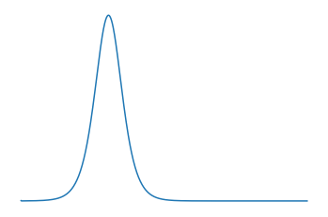
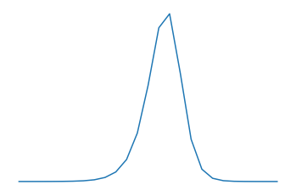
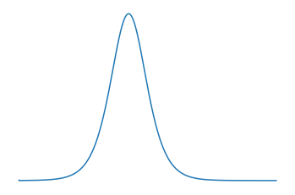
Transmission Model
Transmission Chance
Chance during an exposure that a vulnerable person is infected
Exposure Rate
Number of exposures a person experiences per day
Active Cases
Vulnerable Population
Total Population
New Cases
High Transmission Low Exposure
Balanced
Low Transmission High Exposure

Slide 5

Assumptions
14 day active window
7 day delay – reporting + incubation
7 day rolling average of new cases
Transmission parameters constant throughout month and county

Slide 6
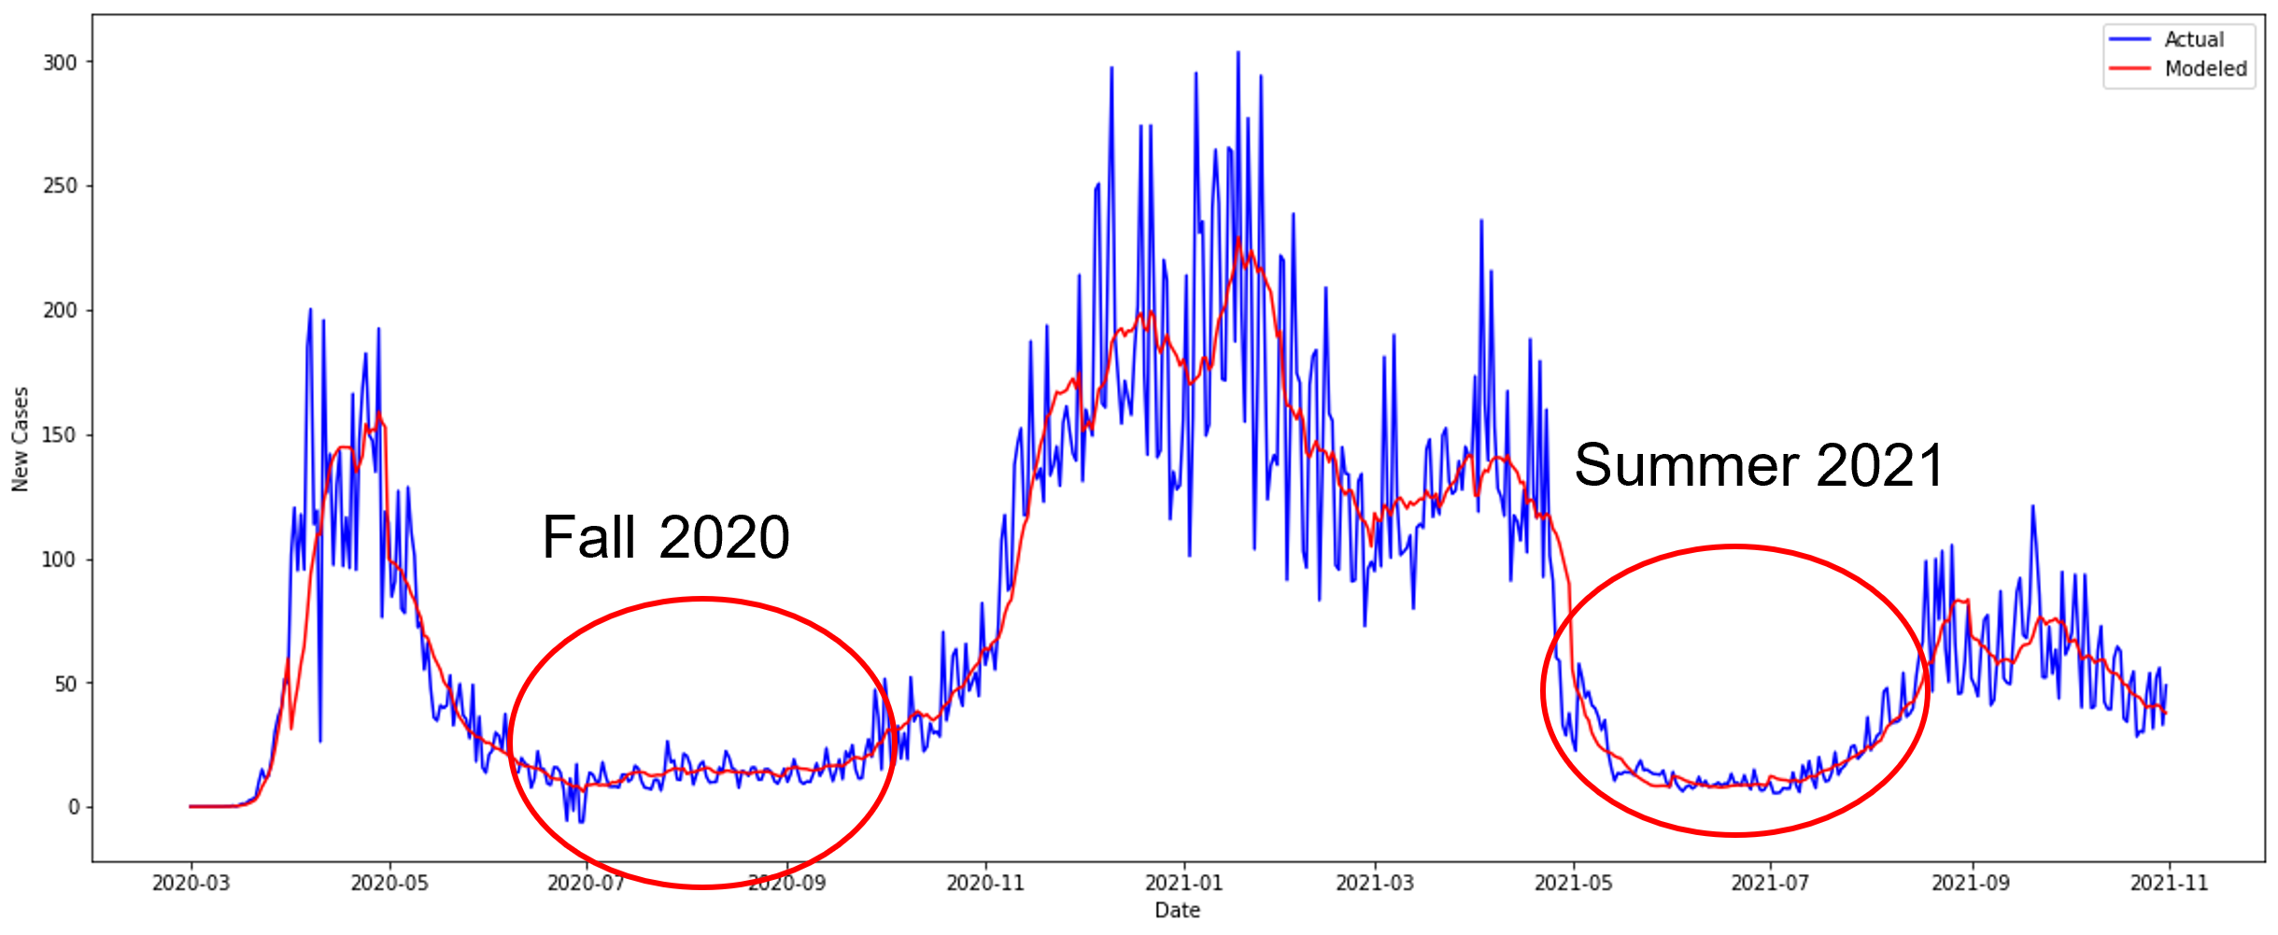
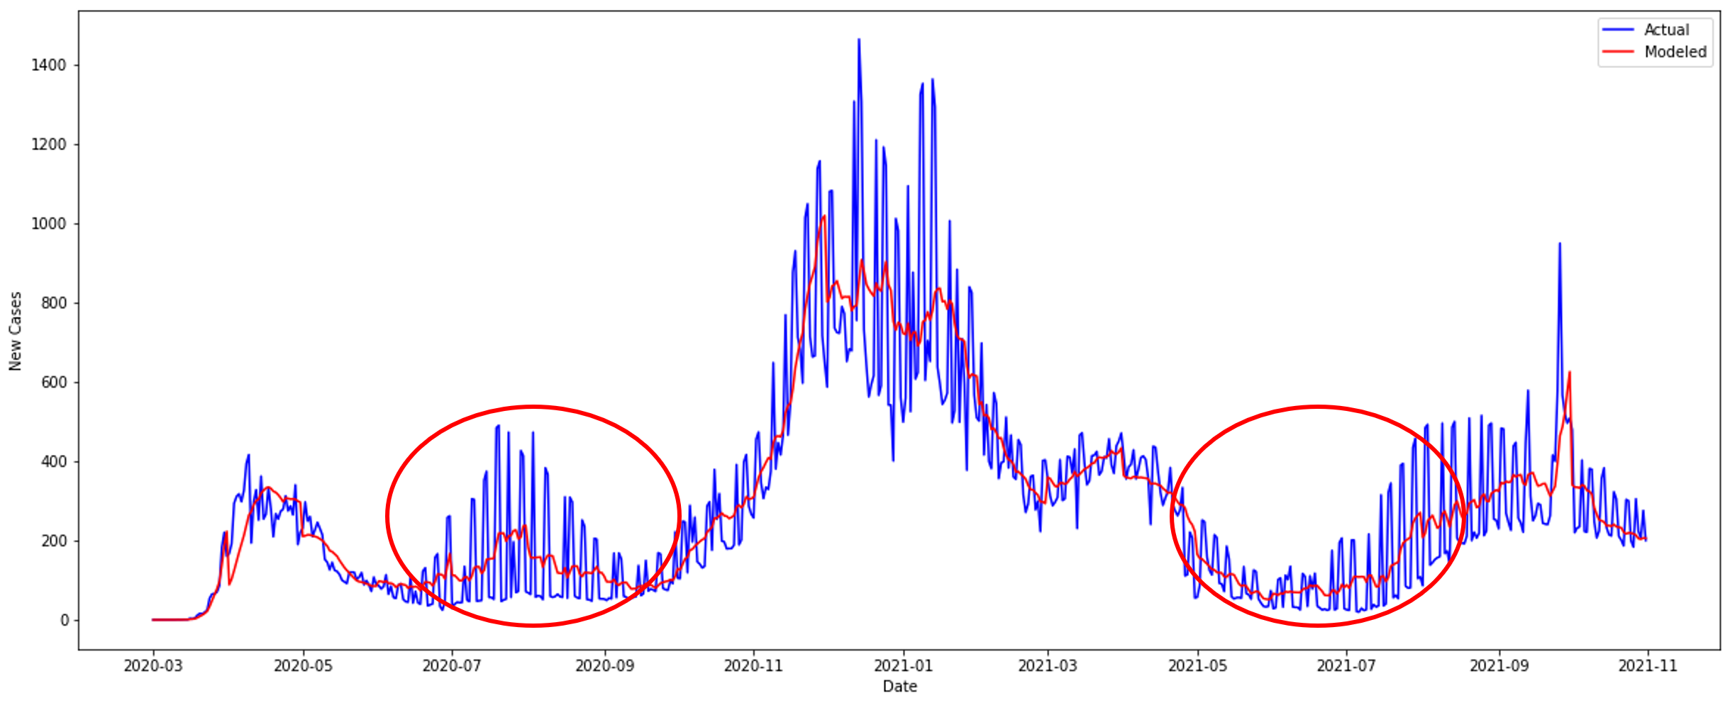
Gwinnett County
Atlanta

Slide 7
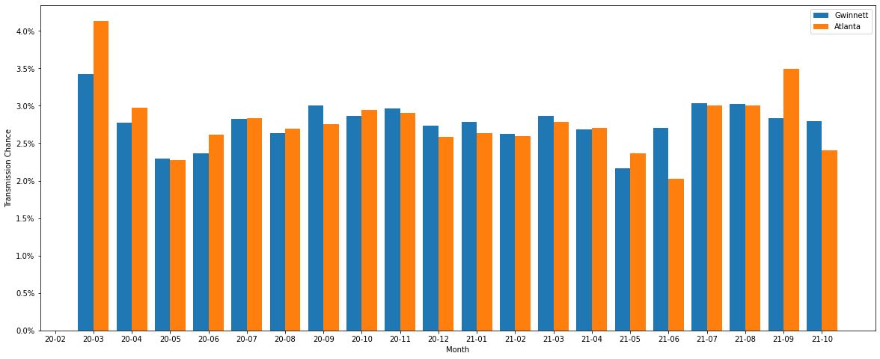
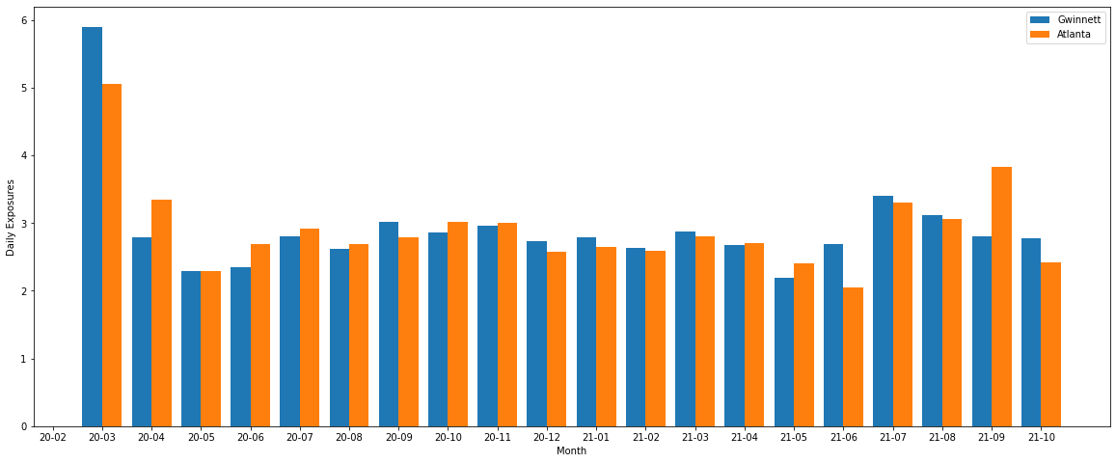
Transmission Chance
Exposure Rate

Slide 8

Compared to Atlanta, Gwinnett County…
Had 0.017 percentage points lower average transmission rate
Had 0.0063 more daily exposures on average
Had 36 more average daily new cases per million people
Had 5,988 more total cases per million people

Slide 9
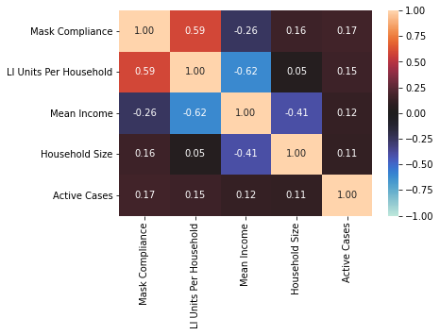
Analysis
Mask Compliance
Estimated as single number
LI Units Per Household
Mean Income
Household Size
Active Cases

Slide 10
What is related to transmission parameters?
Binomial GLM
Linear Regression
Measurement | Transmission Chance | Exposure Rate
Mask Compliance
LI Units per Household
Mean Income
Household Size
Active Cases

Slide 11
Gwinnett vs Atlanta
Mask Compliance: 84% vs 81%
0.2% lower transmission rate
Mean Income: $93,401 vs $99,644
6.2% higher transmission rate
Explained 17.6% of difference in transmission rate
Explained 92.6% of variance in exposure rate
Household Size: 3.11 vs 2.82
0.2 higher exposure rate

Slide 12

Considerations
Model
Regression
Confounding variables
Employment types
Behavior
Data set
Expand to national
Time-series
Mean Income vs Median
Better transition points
Active Cases
Assumed 14 days, could it change?
Population changes
Lost immunity
Deaths/Migration
Isolation

